Slide 1
Time Series Analysis and Predictions
Juan Corchado García, Phd

Slide 2
Table of Contents
Dataset Description
Problem Definition
Techniques for analyzing big data
Exploratory Data Analysis
Autocorrelation Plot
Partial Autocorrelation Plot
Augmented Dicky Fuller Test
Model Building
Holt-Winters
SARIMA
Linear Regression
Random Forest
Comparison

Slide 3
Dataset Description
Dataset name: Taxi Service Trajectory - Prediction Challenge, ECML PKDD 2015 Data Set
Citation: Moreira-Matias, L., Gama, J., Ferreira, M., Mendes-Moreira, J., Damas, L., ”Predicting Taxi–Passenger Demand Using Streaming Data”. In: IEEE Transactions on Intelligent Transportation Systems, vol.14, no.3, pp.1393-1402, September (2013)
Accurate dataset describing complete year (from 01/07/2013 to 30/06/2014) of the trajectories performed by 442 taxis running in the city of Porto, in Portugal. Each data sample corresponds to one completed trip.

Slide 4
Column Description
TRIP_ID: (String) It contains a unique identifier for each trip;
CALL_TYPE: (char) It identifies the way used to demand this service. It may contain one of three possible values:
'A' if this trip was dispatched from the central;
'B' if this trip was demanded directly to a taxi driver at a specific stand;
'C' otherwise (i.e. a trip demanded on a random street).
ORIGIN_CALL: (integer) It contains a unique identifier for each phone number which was used to demand, at least, one service. It identifies the trip's customer if CALL_TYPE='A'. Otherwise, it assumes a NULL value;
ORIGIN_STAND: (integer): It contains a unique identifier for the taxi stand. It identifies the starting point of the trip if CALL_TYPE='B'. Otherwise, it assumes a NULL value;
TAXI_ID: (integer): It contains a unique identifier for the taxi driver that performed each trip;
TIMESTAMP: (integer) Unix Timestamp (in seconds). It identifies the trip's start;

Slide 5
Column Description (cont)
DAYTYPE: (char) It identifies the daytype of the trip's start. It assumes one of three possible values:
'B' if this trip started on a holiday or any other special day (i.e. extending holidays, floating holidays, etc.);
'C' if the trip started on a day before a type-B day;
'A' otherwise (i.e. a normal day, workday or weekend).
POLYLINE: (String): It contains a list of GPS coordinates (i.e. WGS84 format) mapped as a string. The beginning and the end of the string are identified with brackets (i.e. [ and ], respectively). Each pair of coordinates is also identified by the same brackets as [LONGITUDE, LATITUDE]. This list contains one pair of coordinates for each 15 seconds of trip. The last list item corresponds to the trip's destination while the first one represents its start;

Slide 6
Problem Description
Use historical data to predict the amount of taxi trips that will happen on a given hour.
Training will be done on rolling 1 month window of data and the model will be updated daily.
Goodness of fit will be determined by mean absolute percentage error (MAPE)
Goodness of fit will be measured and compared for fitted data, predicted data and the combination of predicted and training data.
8 hour, day, 12 hour and 1 day predictions will be calculated and compared for each model.

Slide 7
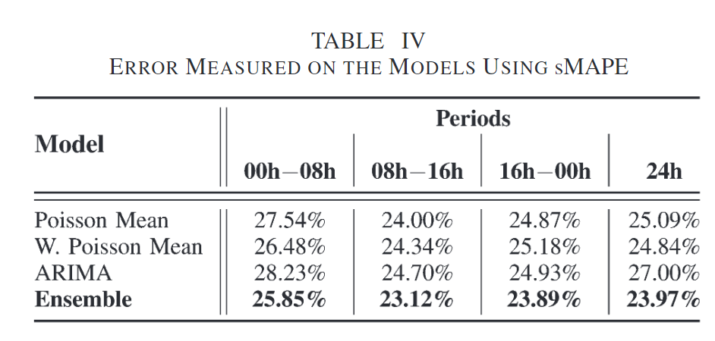
Baseline comparison
Moreira-Matias et al. published a machine learning ensemble on this data set.
They created a heterogeneuous ensemble method to improve prediction of taxi trips per hour
Data is not completely comparable because data treatment and training and test sets were not the same, but it serves as a baseline estimate of the models.
IEEE Transactions on Intelligent Transportation Systems 14(3):1393-1402 DOI: 10.1109/TITS.2013.2262376

Slide 8
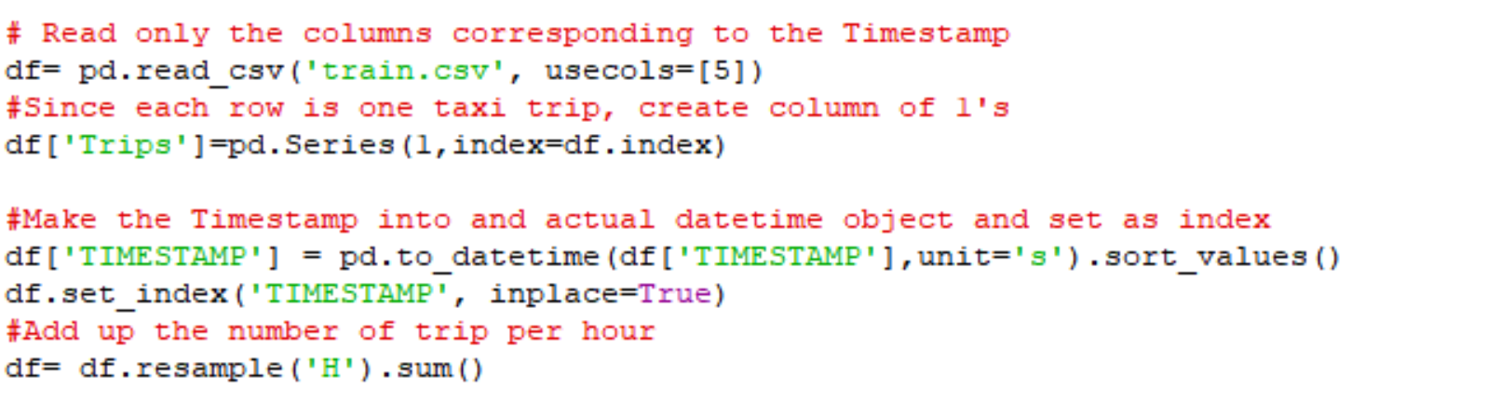
Big Data techniques
Training data is 1.80 GB with 1,710,670 rows and 9 columns. Loading this into memory would require ~3.6GB RAM.
In order to solve the problem, time data and number of trips are needed. Since the number of trips is equal to the number of rows, the information required can be obtained by only loading the column containing the timestamps. This requires 13.1MB of RAM.
A column assigning a value of 1 to each entry is created. 1 timestamp = 1 trip. This doubles the memory requirement to 26.2MB of RAM.
The timestamp is made into the index of the dataframe and then the data is resampled into hourly data.
The summation is performed by pandas in order to use the speed advantages provided by vectorization of the data. Final RAM requirements: 136.9kB.

Slide 9
Exploratory Data Analysis

Slide 10
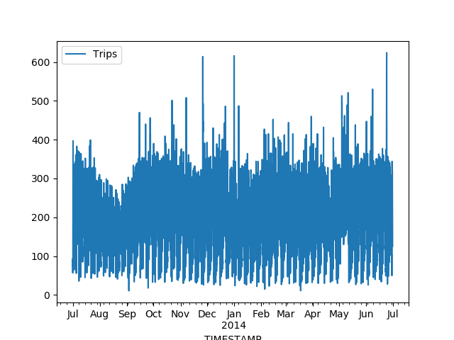
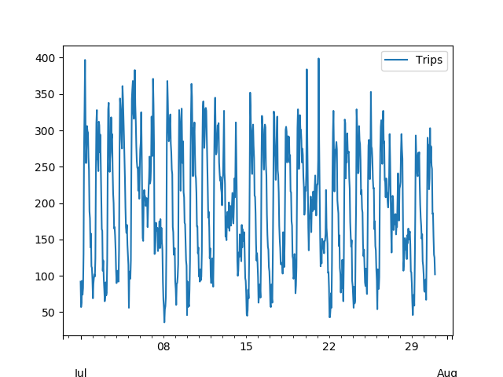
Data Exploration
Full Datal
Data from Jul to Aug
The time series appears to be stationary. There appears to be weekly and daily seasonality

Slide 11
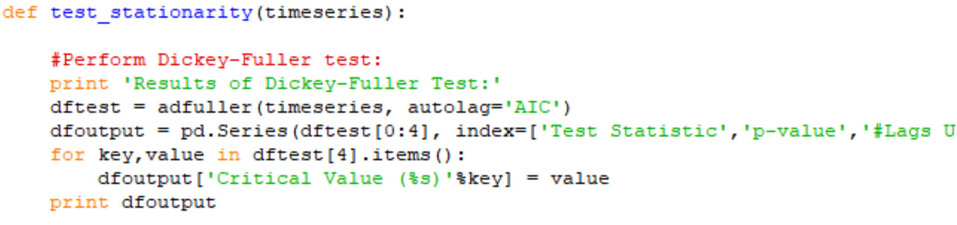
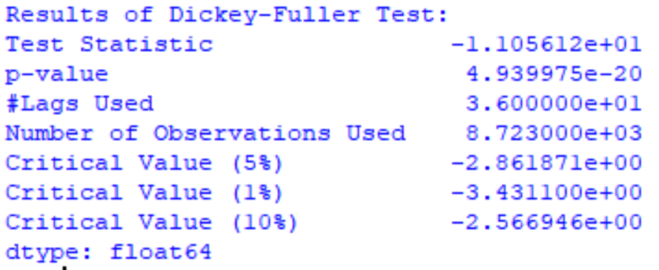
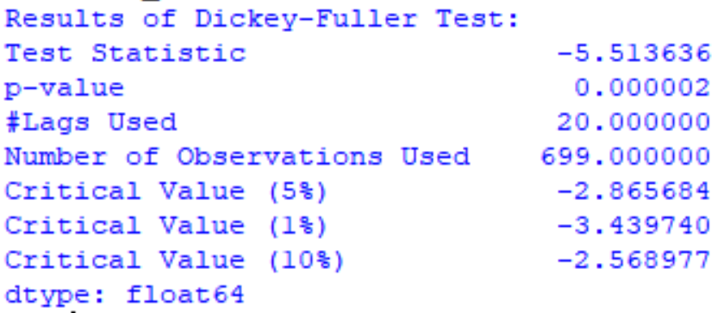
Augmented Dicky Fuller Test
Augmented Dicky Fuller Code
Results for full data
The Augmented Dicky Fuller Test tests if a time series has a unit root.
The null hypothesis of the test is that the time series is non stationary.
The data shows that the time series under study is stationary (null hypothesis rejected) with 99% confidence.
A stationary time series is a series whose variance and mean don’t change as a function of time.
Results for first month

Slide 12
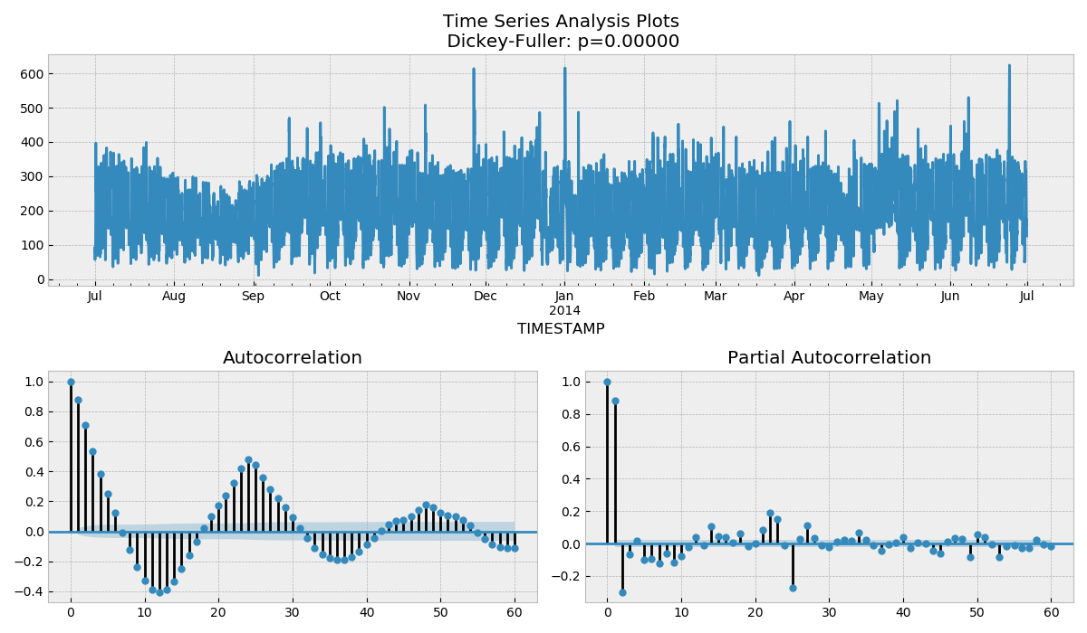
Autocorrelation plot
Clear seasonality can be observed in the Autocorrelation plot (s=12 or 24)

Slide 13
Model Building

Slide 14
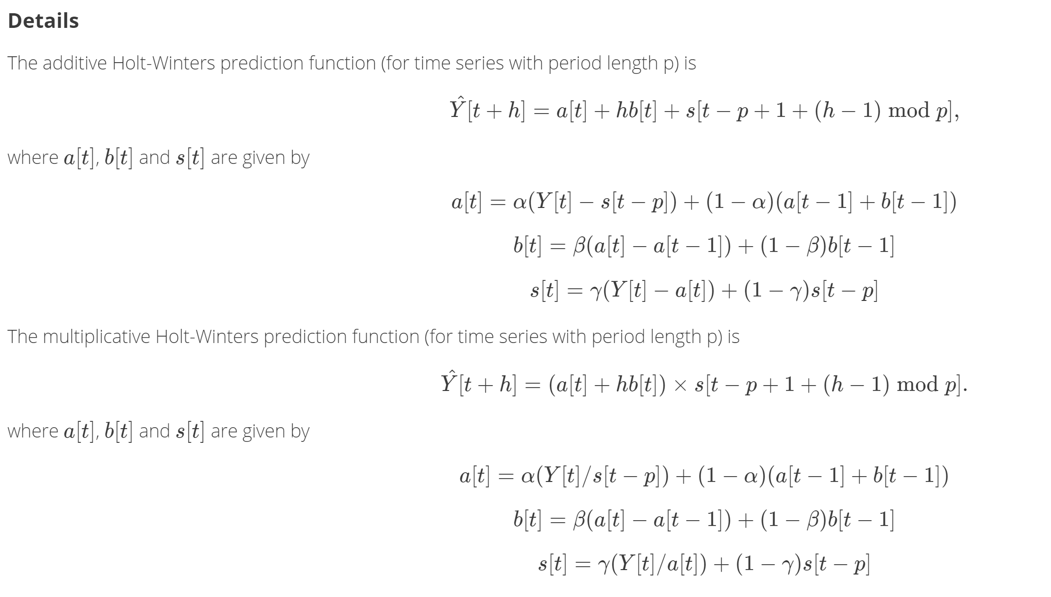
Holt-Winters Method
Method originally developed by Holt for non-season stationary time series (1957).
Winters later modified the procedure to include seasonal trends (1960).
The Holt-Winters method in an algorithm that depends on triple exponential smoothing to model and predict data.
https://www.otexts.org/fpp/7/5
https://www.otexts.org/fpp/7/5
https://www.rdocumentation.org/packages/stats/versions/3.5.0/topics/HoltWinters

Slide 15
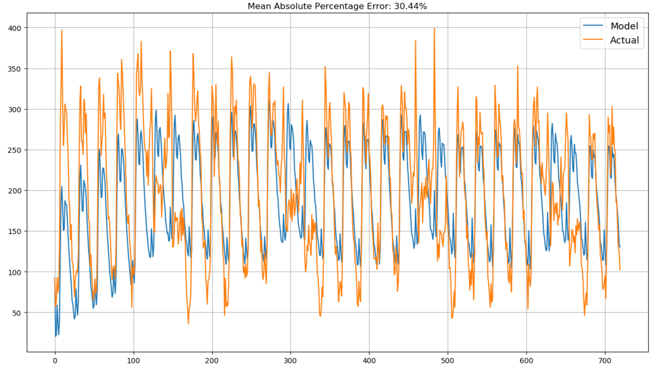
Holt-Winters Method
Comparison with training data

Slide 16
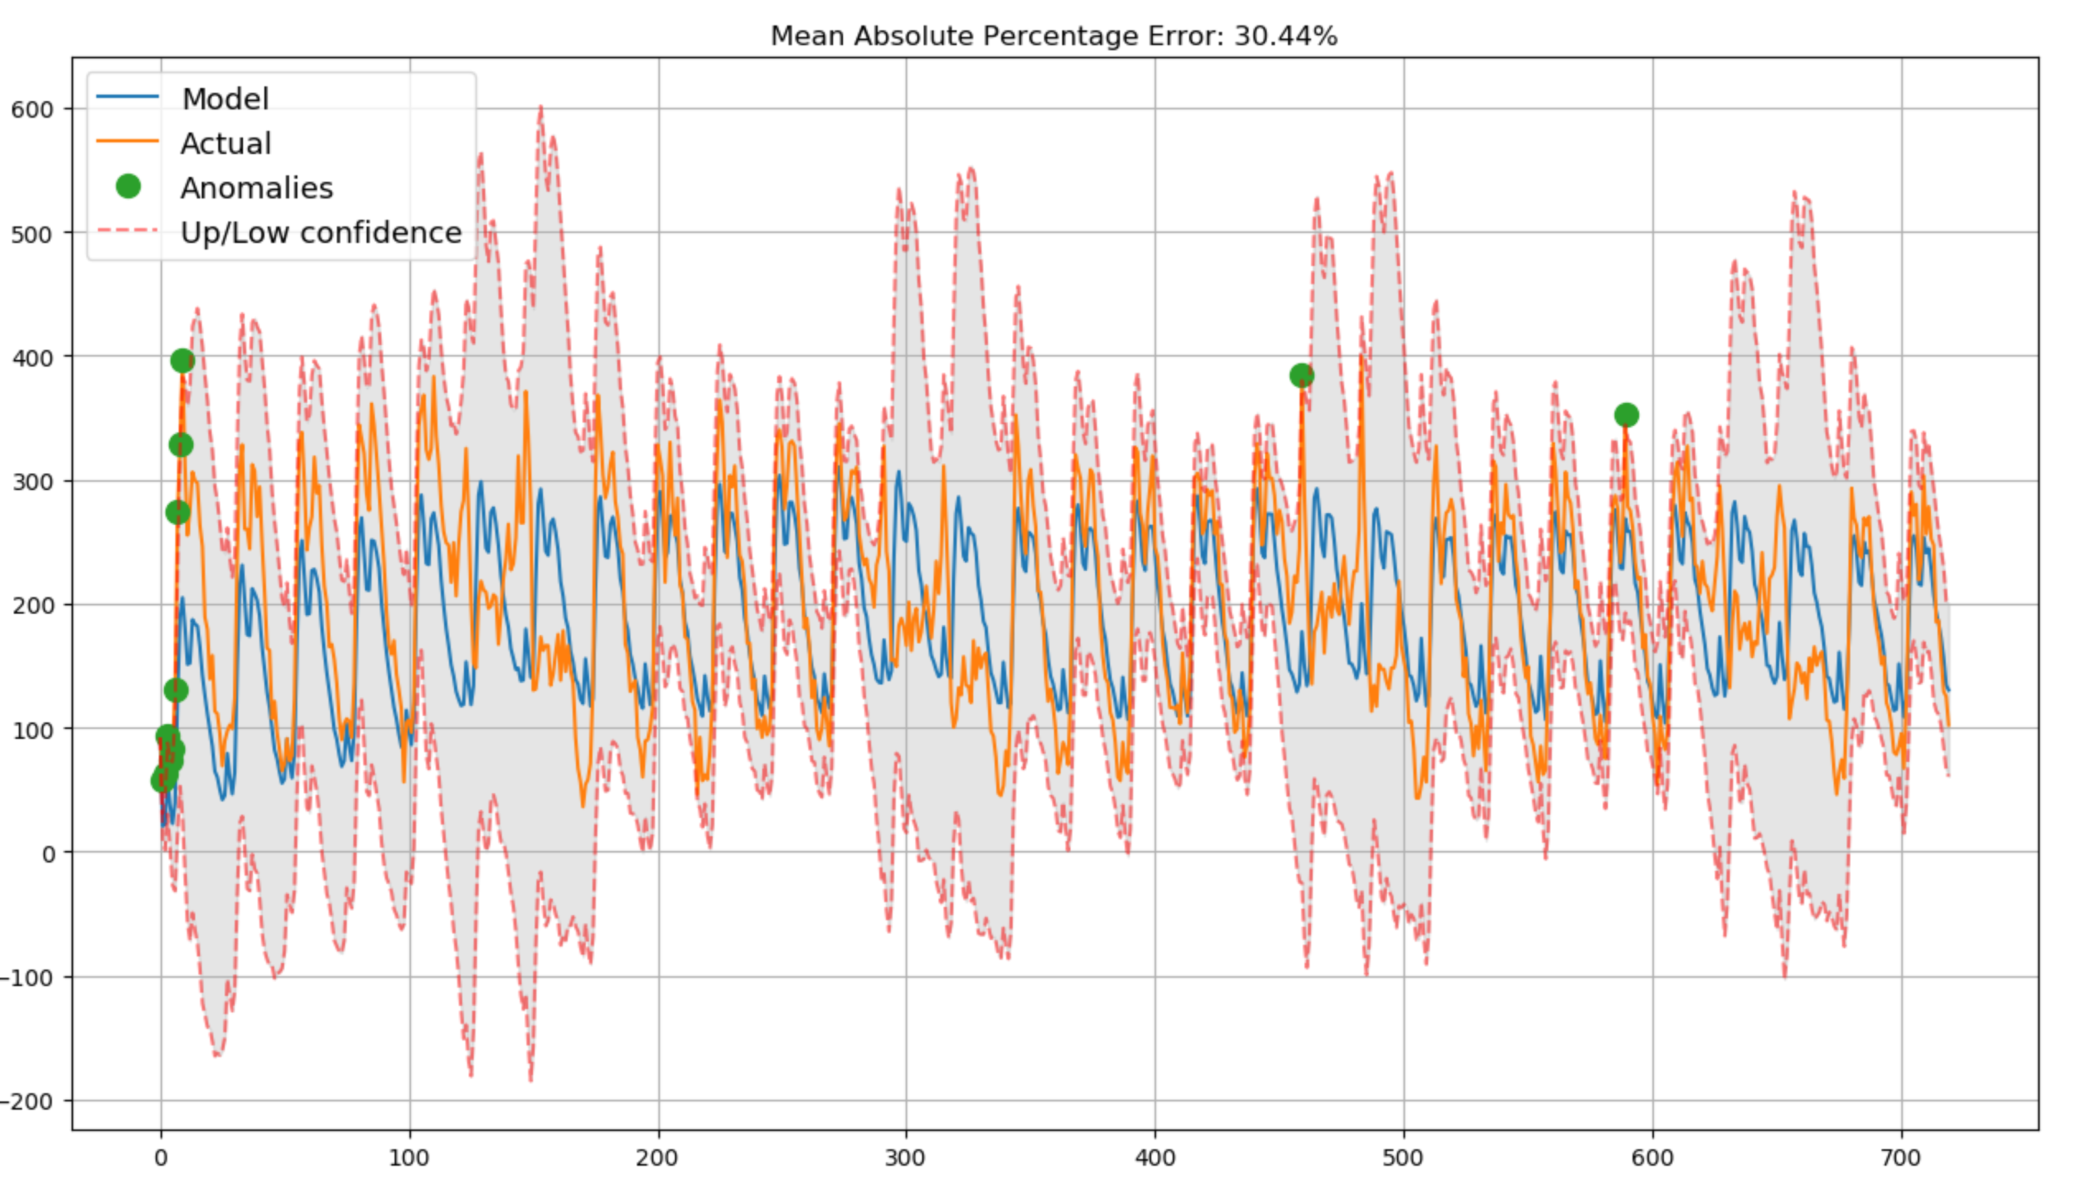
Holt Winters Method
Holt Winters Method comparison to training data
Red dotted lines are the confidence intervals.
Green dots are anomalies detected (outliers)

Slide 17
Holt Winters Method
Prediction | MAPE Prediction | Total MAPE
12h | 35.46% | 30.55%
24h | 25.52% | 30.29%
48h | 18.66% | 29.71%
The model appears to be more accurate after a 24h period

Slide 18
SARIMA Model
SARIMA stands for Seasonal Auto Regressive Moving Average. It seeks to remove autocorrelation, partial autocorrelation and seasonality of a time series in order to fit a model.
A SARIMA model is defined by the parameters (p, q, r)(P, Q, R, S):
p is the auto-regressive part of the model. It incorporates the effect of past values into our model.
q is the moving average part of the model. This sets the error of our model as a linear combination of the error values observed at previous time points.
d is is the integrated part of the model. This includes terms in the model that incorporate the amount of differencing (i.e. the number of past time points to subtract from the current value) to apply to the time series.
P, Q, and R are the same as p, q , r but applied to the seasonal component. S is the season component (12 = monthly, 24 = daily, etc)

Slide 19
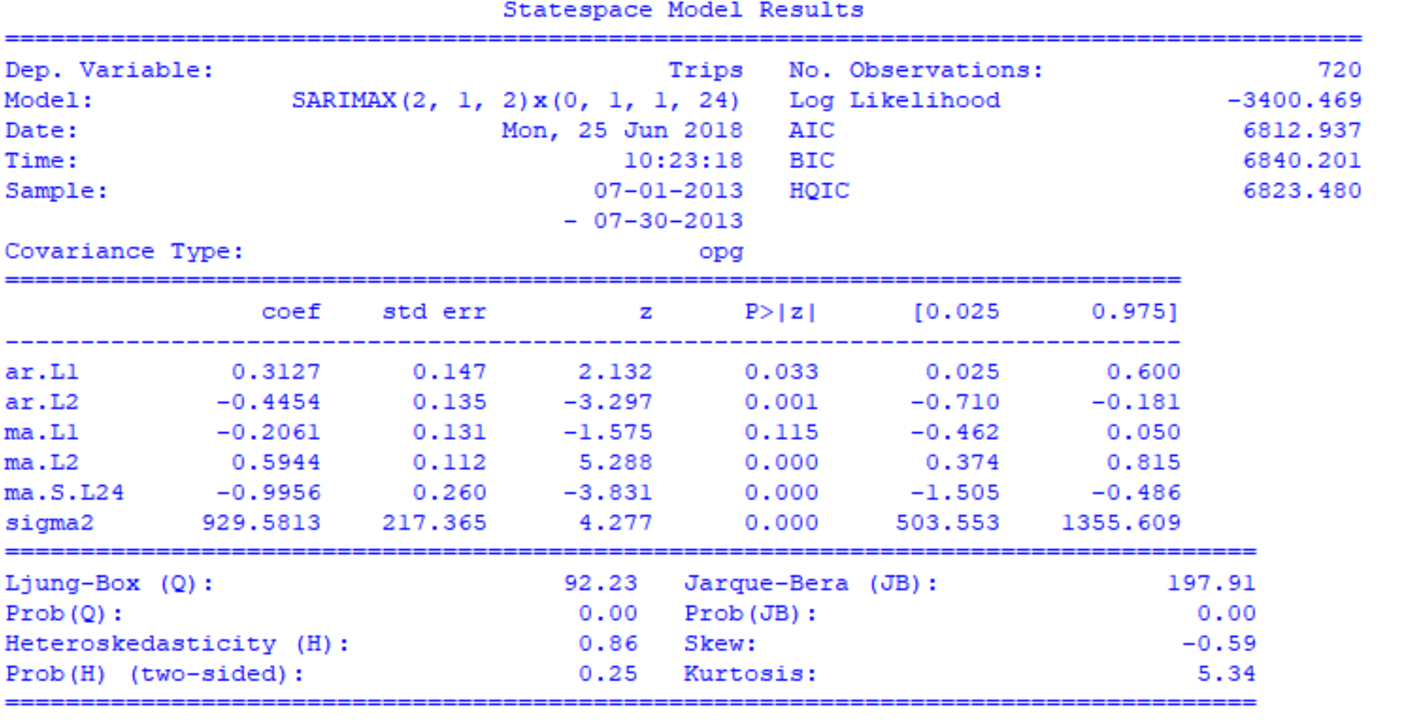
SARIMA Model
Summary table SARIMA parameters
Hyperparameter optimization was done using a grid search method
The best hyperparameter combination was SARIMA(2, 1, 2)x(0, 1, 1, 24)

Slide 20
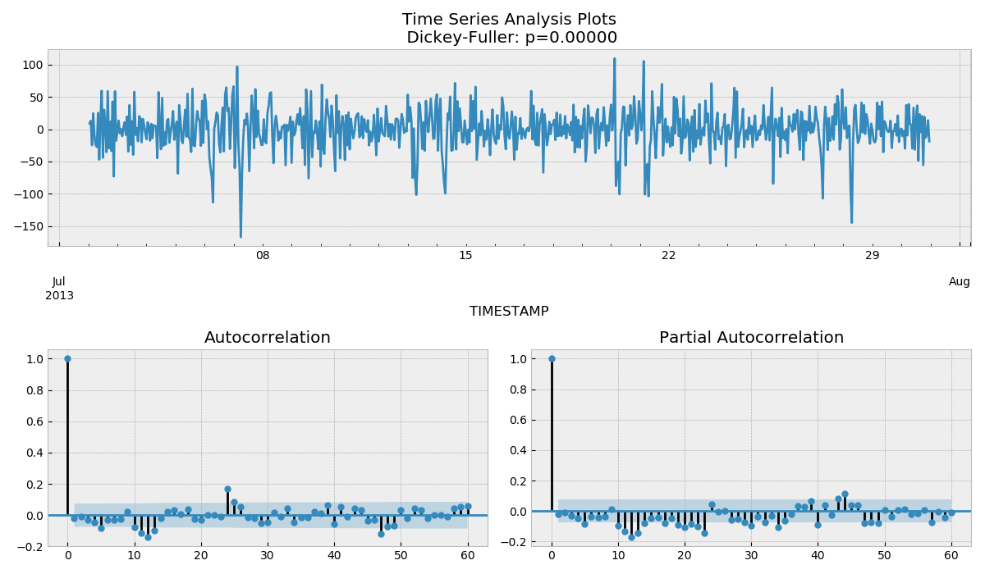
SARIMA Model
Augmented Dicky Fuller test shows the model is stationary.
Autocorrelation and partial autocorrelation has been greatly reduced.
No visible seasonality.

Slide 21
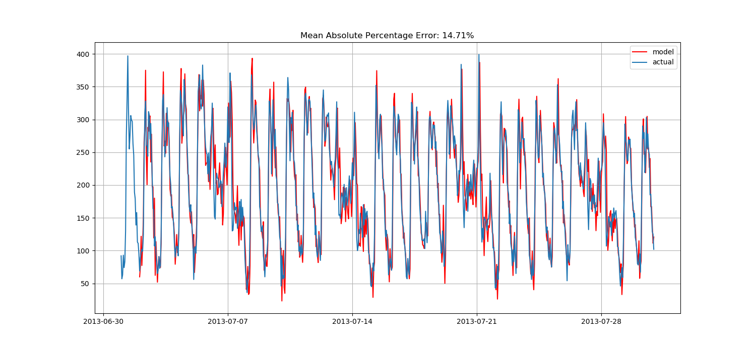
SARIMA Model
SARIMA Comparison to Training Set

Slide 22
SARIMA Results
Prediction | MAPE Prediction | Total MAPE
12h | 23.66% | 19.52%
24h | 21.36% | 15.29%
48h | 18.43% | 15.29%
1 month | 24.97% | 20.03%
Predictions from the SARIMA model are very good but hyper-parameter optimization requires a lot of computational time to complete. Accuracy is kept high even at 1 month predictions

Slide 23
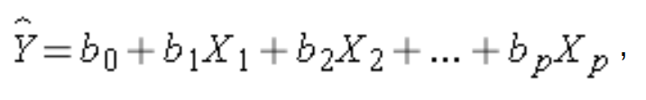
Linear Regression
Linear regression tries to optimize a linear relationship between observed variables and predicted variables.
The model tries to optimize the parameters b_{n}.
Feature selection and optimization (regularization) can be done by Lasso or Ridge.
Multiple Linear Regression equation

Slide 24
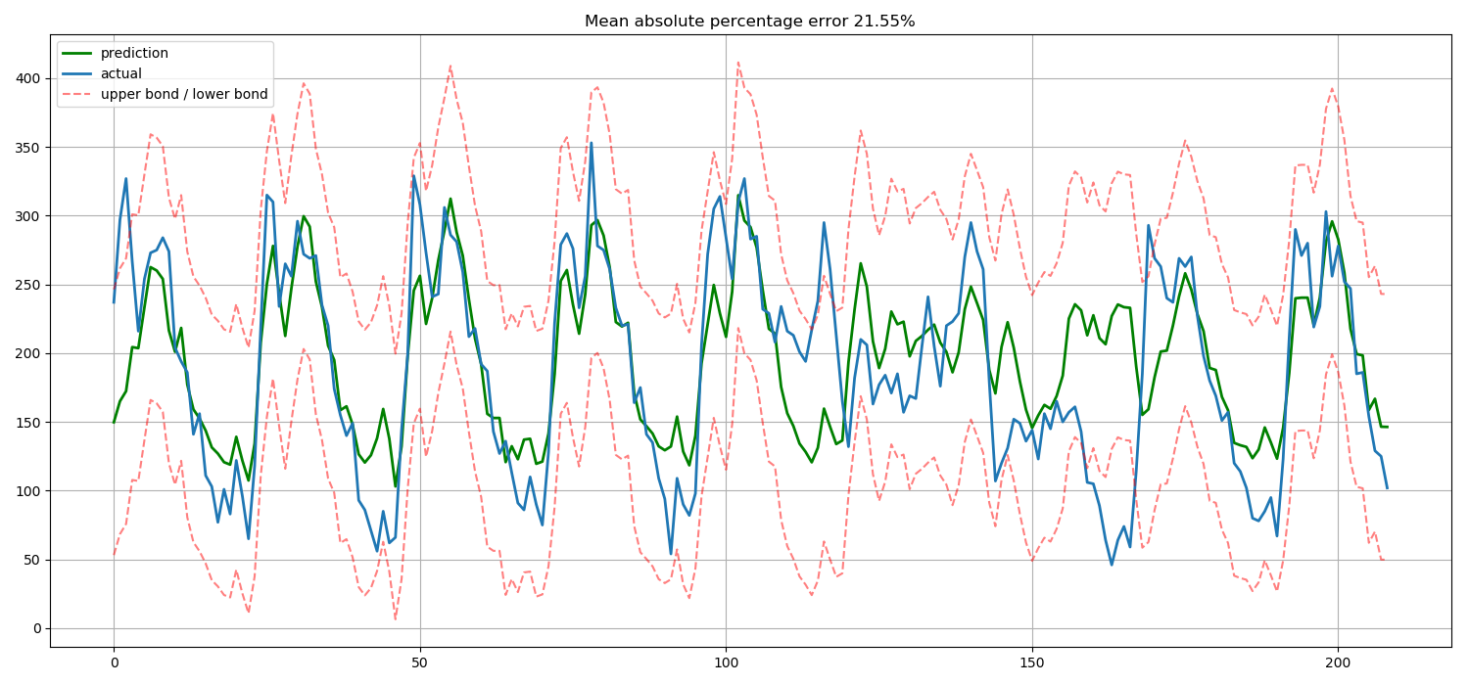
Linear Regression
The Linear Regression model was fitted using only self-correlation

Slide 25
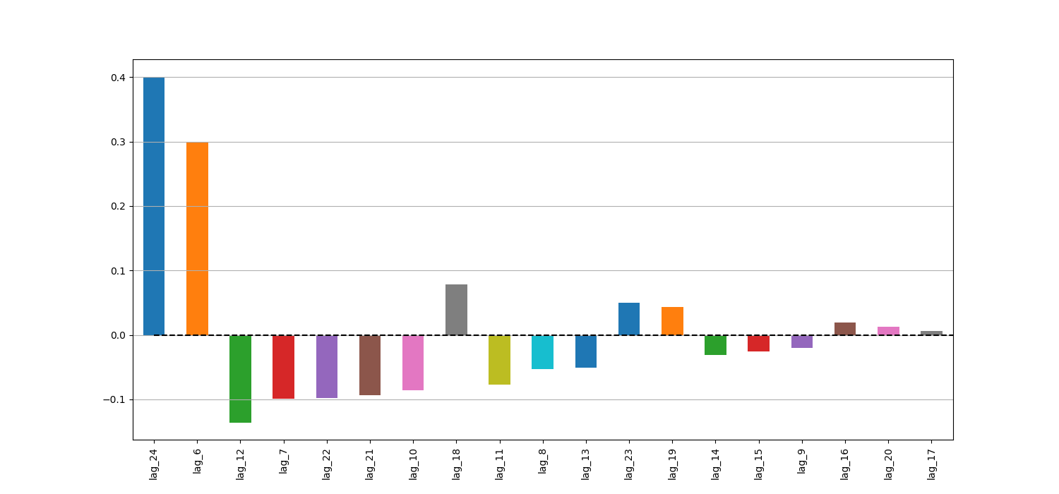
Linear Regression
Relative feature importance – Only Lags

Slide 26
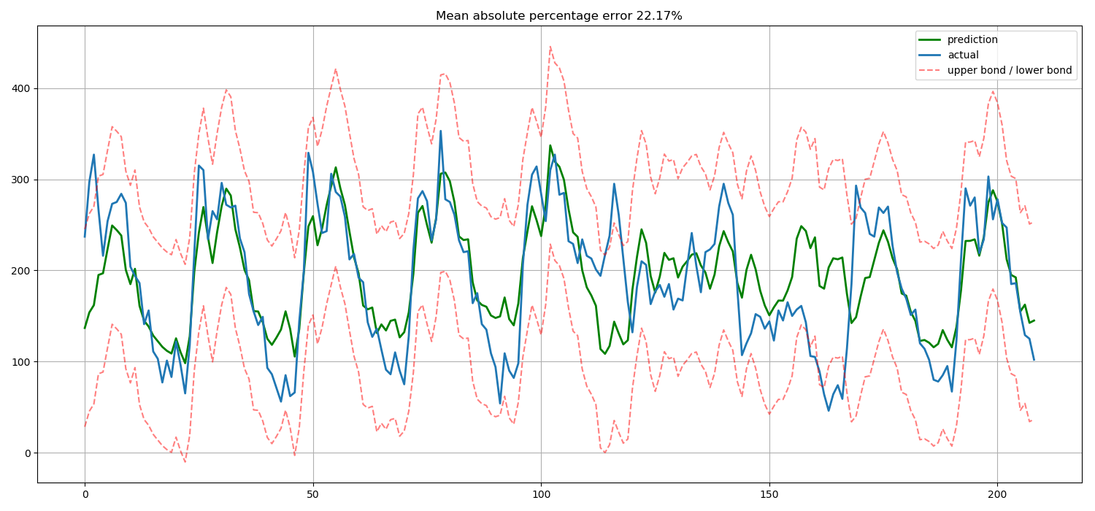
Linear Regression
The model was improved by adding categorical variables: weekdays, hours and weekends

Slide 27
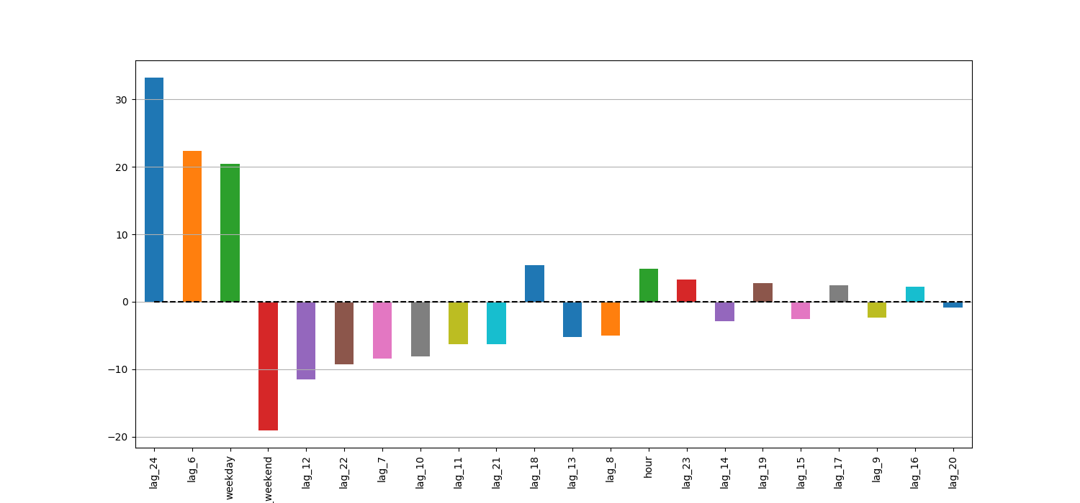
Linear Regression
Relative feature importance – Lags and categorical
Weekday and weekend categorical variables did not improve the model

Slide 28
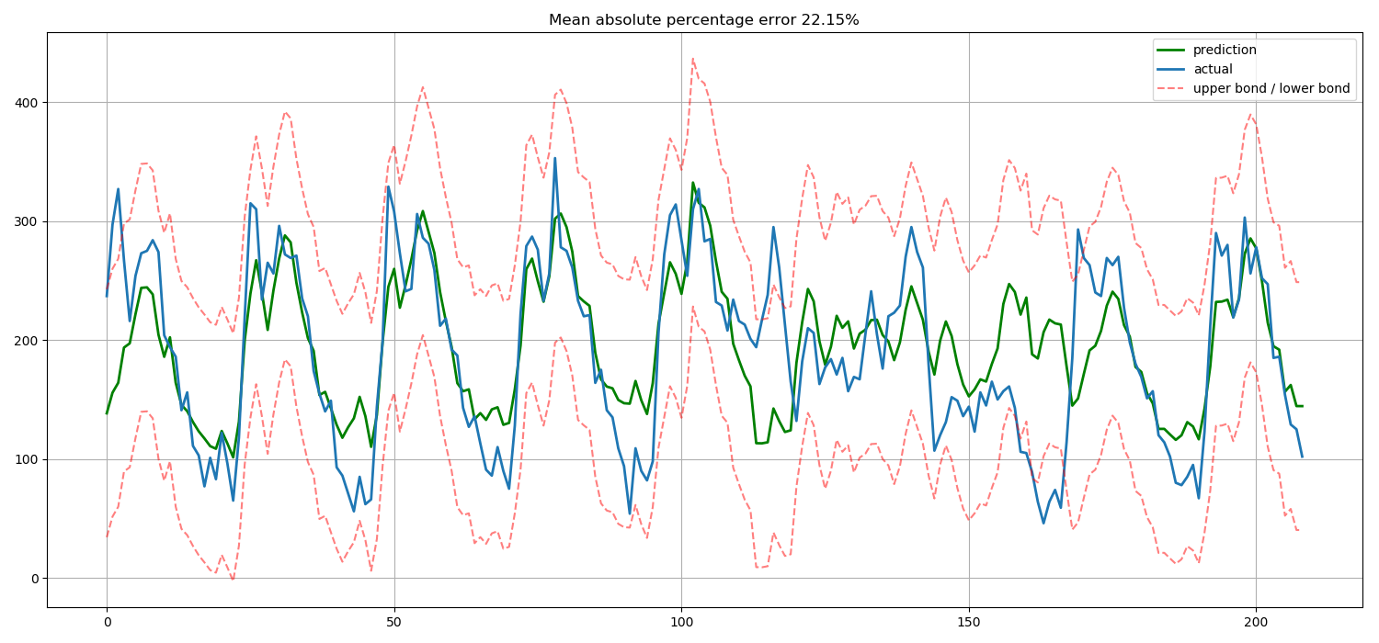
Linear Regression
Lasso only slightly improved the fit

Slide 29
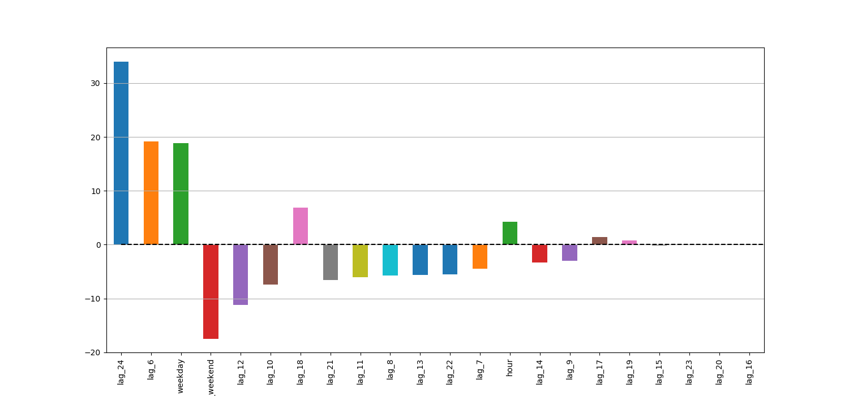
Linear Regression
Relative feature Lasso lags and categorical

Slide 30
Linear Regression Model
Prediction | MAPE Prediction | Total MAPE
12h | 19.22% | 32.61%
24h | 15.69% | 32.28%
48h | 23.36% | 32.24%
The model with no categorical variables was used due to its smaller MAPE

Slide 31
Random Forest
Creates many decision trees with randomly selected features and random sample selection with replacement (baggin)
An aggregated score of relative feature importance is determined.
Algorithm decreases variance of the model without increasing bias
Features for the model were the lags from 6 to 24, hour, weekend and weekday labels.
1000 trees were trained

Slide 32
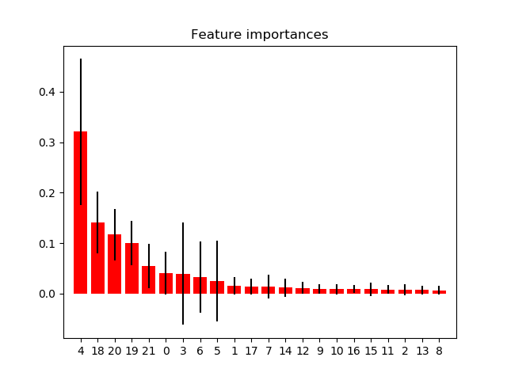
Random Forest
Feature List:
0 = lag_6
1 = lag_7
2 = lag_8
3 = lag_9
4 = lag_10
5 = lag_11
6 = lag_12
7 = lag_13
8 = lag_14
9 = lag_15
10 = lag_16
11 = lag_17
12 = lag_18
13 = lag_19
14 = lag_20
15 = lag_21
16 = lag_22
17 = lag_23
18 = lag_24
19 = hour
20 = weekday
21 = is_weekend

Slide 33
Random Forest
Prediction | MAPE Prediction | Total MAPE
12h | 7.26% | 7.22%
24h | 10.32% | 10.32%
48h | 13.38% | 13.39%
1 week | 17.25% | 13.29%

Slide 34
Comparison Between Models and Literature

Slide 35
Model Comparison
Model | 12h MAPE | 24h MAPE | 48h MAPE | 1 week MAPE
Holt-Winters | 35.46% | 25.52% | 18.66% | -
SARIMA | 19.22% | 15.69% | 23.36% | -
Linear Regression | 19.22% | 15.69% | 23.36% | -
Random Forest | 7.26% | 10.32% | 13.38% | 17.25%
The Random Forest model gave the best predictions even at time scales far from the training set. Furthermore, training time with 1000 trees is less than 1 minute.

Slide 36
Comparison with Literature
Results from literature
Random Forest Model
Prediction | MAPE Prediction | Total MAPE
12h | 7.26% | 7.22%
24h | 10.32% | 10.32%
48h | 13.38% | 13.39%
1 week | 17.25% | 13.29%
The random forest model developed here seems to outperform the ensemble method developed in the publication
IEEE Transactions on Intelligent Transportation Systems 14(3):1393-1402 DOI: 10.1109/TITS.2013.2262376

